Slide 1
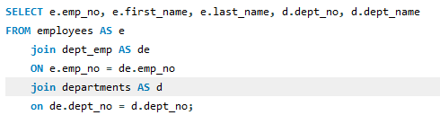
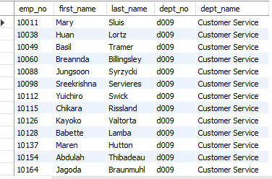
1. List of employees by Department
Write a query to list all employees along with their respective department name - include employee number, first name, last name and department no
Output

Slide 2


2. Current and Past salaries of an employee
Write a query to retrieve all the salary records of a given employee (by
employee number) including employee number, salary, from date
Output

Slide 3

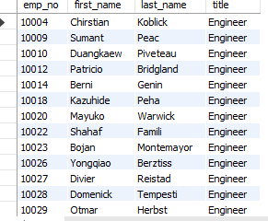
3. Employee with specific titles–
Write a query to find all employees who have held a specific title—
( 'Engineer’) include employee number, first name and last name
Output

Slide 4
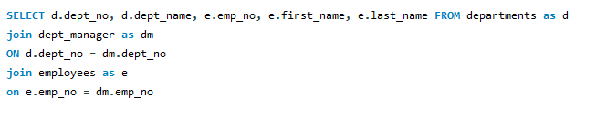
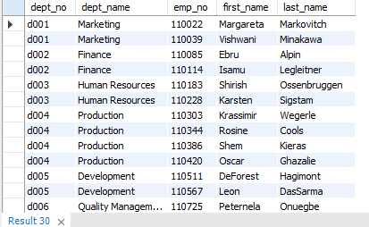
4. Departments with their Managers–
Write a query to list all departments along with their current manager,
including department no. name, employee no. first name and last name
Output

Slide 5

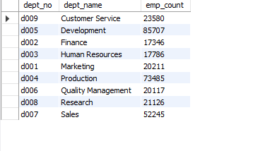
5. Employee Count by Department –
Write a query to count the no. of employees in each department.
include-department number, department name, employee count
Output

Slide 6

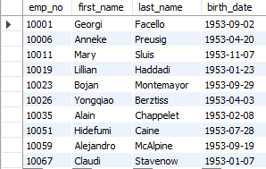
6. Employees Birthdates in a given year
Write a query to find all employees born in a specific year (e.g.1953- include
year, employee no. first name, last name
Output

Slide 7

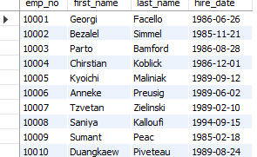
7. Employees hired in the last five years-
Write a query to find all employees hired in the last 50 years.- include
employee no. first name, last name, first date
Output

Slide 8
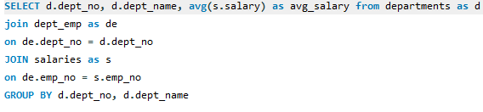
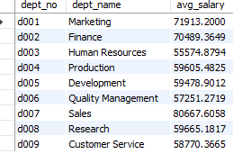
7. Average salary by department –
Write a query to calculate the average salary for each department. Include
department employee no. first name, last name, first date
Output

Slide 9
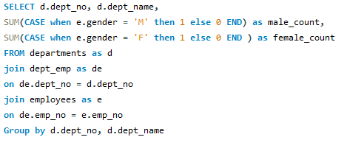
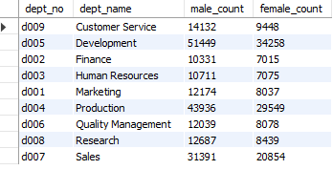
9. Gender distribution in each department –
Write a query to find gender distribution (no. of males and females) in
each department -- include department no. department name, male and
female count
Output

Slide 10

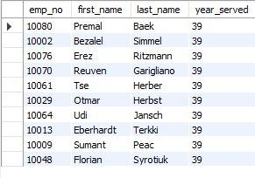
Longest serving employee- Question: Write a query
to find the employees who have served the longest
in the company - include employee no., first name
and last name
Output

